Slide 1

CIS550 Project Demo
Mini Yelp
Shan Luo, Gongyao Chen, Hanlin Xiao, Zhenchi Zhang

Slide 2
CIS550 Project Demo
Design a simplified web application similar to Yelp.
User Registration, login
Search shops by city, feature, open time
Get nearby shops by address, feature
Get popular shops by city, feature
Get user reviews by shop

Slide 3
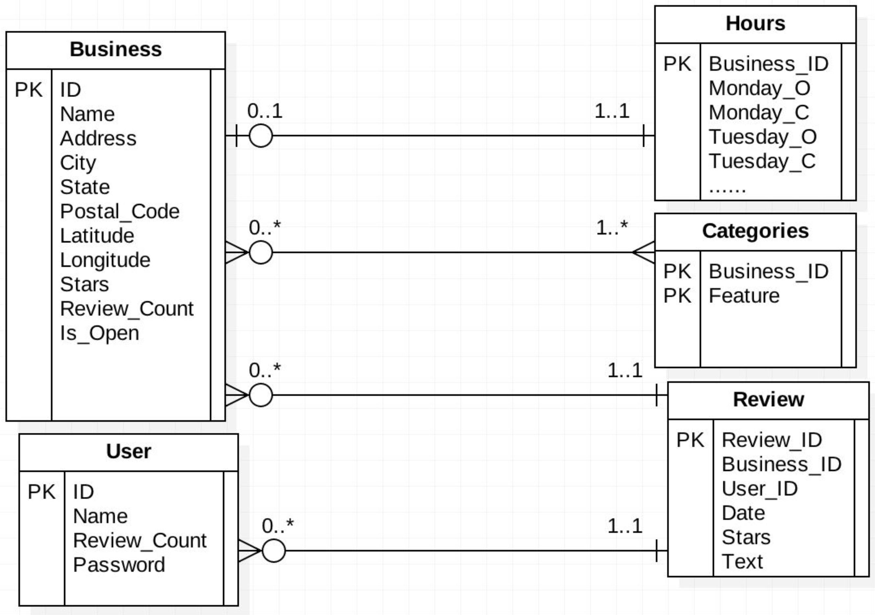
CIS550 Project Demo

Slide 4
CIS550 Project Demo
Demo Time

Slide 5
CIS550 Project Demo
Questions

Slide 6
CIS550 Project Demo
Thank You!

